Slide 1
Leisure Time Travel
Member Meeting
Leisure Time Travel
Member Meeting
RELAX
INDULDGE

Slide 2
Rick Flores

Slide 3
Part 1
Who we are
Travel Industry Overview
Club Review
Part 2
New Direction
Options (Right of Refusal)
Q&A
Agenda

Slide 4
Member Services Team

Slide 5
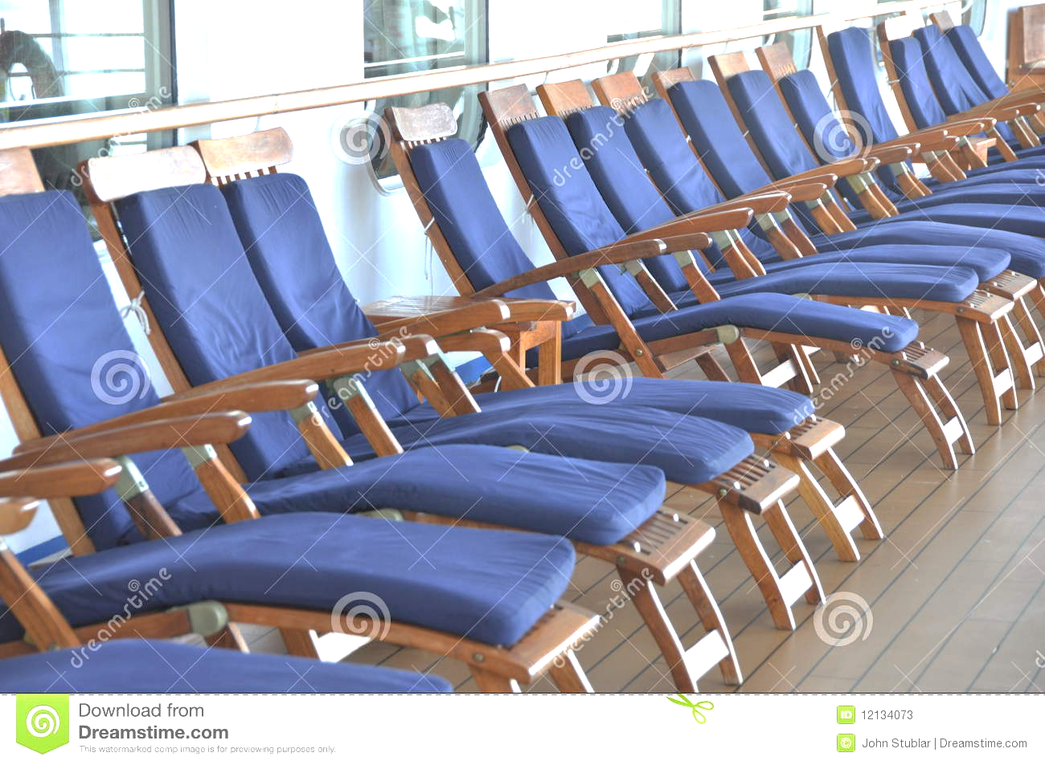
Who We Are
The Premier Group
Est. 1994
Over a million members serviced
Mergers
Acquisitions
Product development
New affiliations

Slide 6
Objective
To help you get value out of your travel program
To answer any and all questions you may have
To show you what we are doing as a company to stay on the cutting edge of the travel industry through our new products

Slide 7
Affiliation
PARENT CO.
LEISURE TIME TRAVEL
Funseeker Matrix Travel Network
Castaway Vacation Club Coconut Club Vacations
Sealand Travel Island Trader Vacations
Outrigger Vacation Club Tradewinds Vacations
Phoenix Vacations
YOU

Slide 8
Affiliation
LEISURE TIME TRAVEL
FRANCHISEE
YOU

Slide 10
Membership Review
Request Based
Choose Trip from Website
Submit Request
Flexibility on Dates & Destination (3)
Agent will contact
Confirm
$199 Yearly

Slide 11
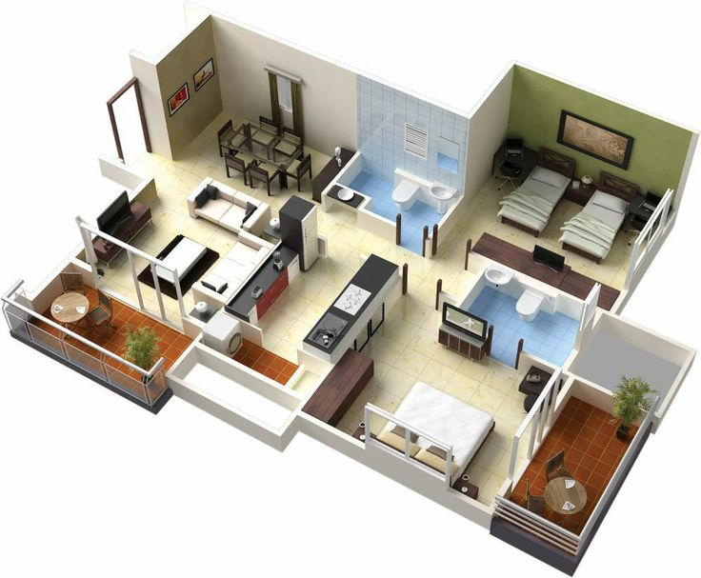
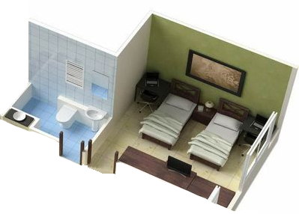
Why Club
1 Week of timeshare
Average week $15,000
Annual maintenance fee $800
Average nightly hotel $150
7 nights $1,050

Slide 12
Industry Milestones
1960s
Vacation Commitment
1970-1990s
2nd Home
Hotels
Visit family
Timeshare
1996
Travel Clubs
2017
Leisure Time Travel Platform Direct
2000
First internet based travel company
2011
Baby Boomers begin retiring

Slide 13
Your choice
2nd half

Slide 14
Member Surveys

Slide 15
Customer Satisfaction and Product Development
Findings
Ease of use
Value
Flexibility

Slide 16
New Product Highlights
Online Booking
Reserve vs Request
Increase Condo Inventory
500% Increase
Hotels
250% Increase
Cruise Lines
128% Increase
International travel
192 Countries
Complementary vacations
30 Transferable
Vacation credits
Good for 10 years
Family & friends memberships
Five free
Camping
over 1500 resorts

Slide 17
Greeting / welcome
Mission
Agenda
Acridity
Vision
Surveys
New product
1st ROR
never today
incentives
New Product First Right of Refusal
Keep as-is
Honored 100%
Addendum/ New product
Limited

Slide 18
Standard
New
Condominium resorts
100k resorts to request
Hotel
20k Properties US
Cruises
15 Cruise lines
Friends & family
N/A
Camping
N/A
Vacation currency
N/A
Retail benefits
N/A
Camping
Passport America
1500 + RV resorts
at 50% off
Vacation currency
Earn vacations on
condos, hotels, package
deals
Retail benefits
Over 250 million retail
offers, mobile app
Condominium resorts Over 500k to reserve
Bonus & Hot Weeks
Hotel
500k properties in 120
Countries
Cruises
192 cruise lines
including river cruises
Friends & family
Full access for 5 family or
friends

Slide 19
Original locations 100,000 weeks

Slide 20
New locations 500,000 weeks

Slide 21
Standard
New
Condominium resorts
100k resorts to request
Hotel
20k Properties US
Cruises
15 Cruise lines
Friends & family
N/A
Camping
N/A
Vacation currency
N/A
Retail benefits
N/A
Camping
Passport America
1500 + RV resorts
at 50% off
Vacation currency
Earn vacations on
condos, hotels, package
deals
Retail benefits
Over 250 million retail
offers, mobile app
Condominium resorts Over 500k to reserve
Bonus & Hot Weeks
Hotel
500k properties in 120
Countries
Cruises
192 cruise lines
including river cruises
Friends & family
Full access for 5 family or
friends

Slide 22
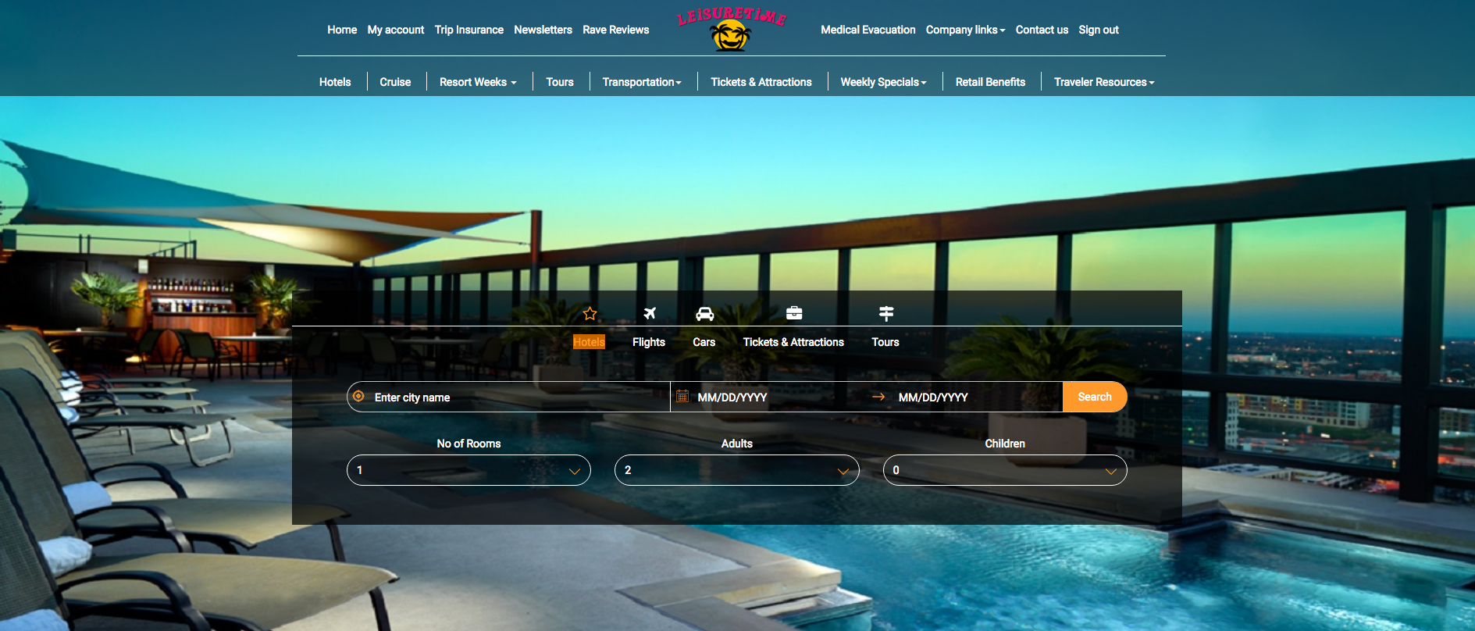

Slide 23
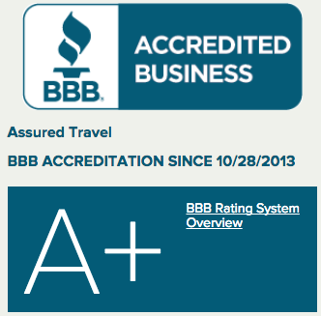
Platinum Passport
Over 30 vacations
Complimentary accommodations 50 nts @ 12.50
All-Inclusive resorts 50% off
Carnival cruises 60% off
Royal Caribbean cruises 60% off
Prepaid and discounted airfare
Fully transferable
Easily shared with friends and family
Easy and convenient
Online reservation
Value up to $4,895

Slide 25
2018 Platinum Pricing
New members $ 11,890
Down payment $2,377
Installments $ 202
Dues $399

Slide 26
Platinum Equity
New members $ 11,890
Equity exchange <$7,220>
$ 4,670
Dues frozen $199

Slide 27
Webinar Concession
New members $ 11,890
Equity exchange <$8,220>
$ 3,670
Dues frozen $199

